Slide 1


Space Technology Mission Directorate
Game Changing Development Program FY2016 3rd Quarter Review
National Aeronautics and
Space Administration
Human Exploration Telerobotics 2 (HET2)
Terry Fong and Maria Bualat
July 19, 2016
^{TECHNOLOGY DRIVES EXPLORATION}

Slide 2
Project Manager’s 3rd Quarter Assessment
Technology | Performance |  |  |  | Comments
 | T | C | S | P
Astrobee |  |  |  |  | Schedule – Minimal margin for cert and flight unit builds. Addressing tight schedule via overlapping builds (incurs risk due to build of some flight components prior to completion of cert unit testing). Programmatic – Technology transition to customer will be incomplete if current project scope is not increased. A one-year (FY18) extension required for check-out and commissioning activities on ISS. Note: PPBE18 PAA briefing lists on-orbit commissioning as FY18 deliverable, but no formal decision memo extending the project has yet been provided.
Vision based navigation |  |  |  |  | Small, mobile vision based navigation system for operating in 6 DOF
Fan based propulsion |  |  |  |  | Operate autonomously within ISS safety constraints
ISS 3D path planning |  |  |  |  | Path planning inside ISS
Zero-G robotic perching |  |  |  |  | Perching on ISS structure to conserve consumables

Slide 3
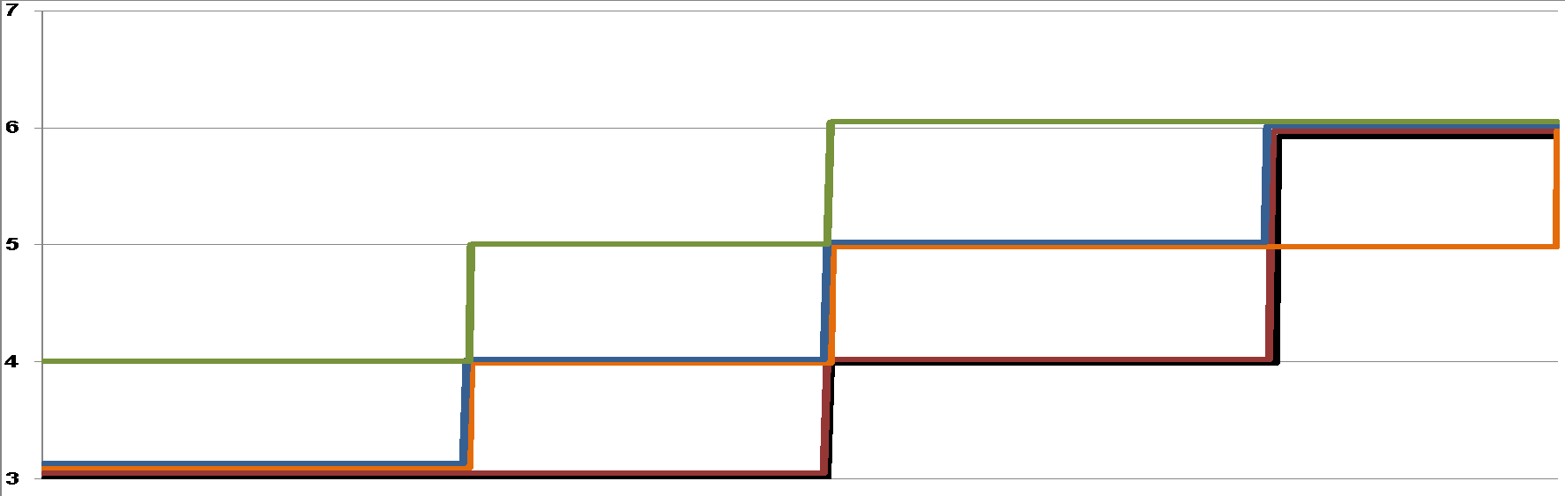
Astrobee Free-Flyer TRL/KPP Assessment
5
0
Q3 Review
Goal
Flight Time
(hr)
Threshold
50
10
Goal
Velocity
(cm/sec)
Threshold
Prototype 4 testing complete (4/2016)
Cert Unit testing complete (3/2017)
Flight Unit testing complete (8/2017)
PTR 2
(10/2016)
PTR 1
(2/2015)
Prototype 3 testing complete (8/2015)
PTR 3
(6/2016)
TRL
Prototype 2 testing complete (2/2015)
FY15
FY16
FY17
Astrobee Free-Flyer
Fan based propulsion
Controlled Milestone
Zero-G robotic perching
Key Milestone
Vision based navigation
Project Milestone

Slide 4
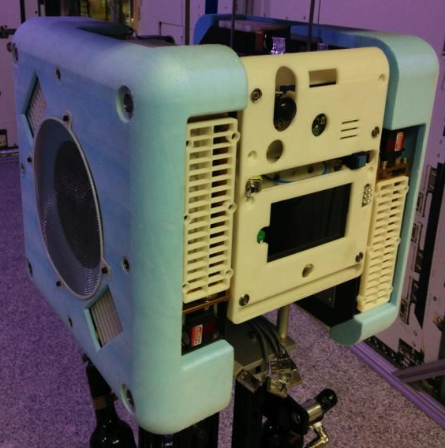
Accomplishments and Technical Challenges
Controlled Milestone FY16#1: Prototype 4 testing complete
Prototype 4 reflects flight-like hardware design
Verified requirements related to hardware design
Drafted integration & test procedures for Cert Unit
Collected lessons learned for Cert Unit development
Challenges
3D printed structure not appropriate for some tests (thermal and EMI)
Mass exceeds 6 Kg target
Collision mitigation design
Astrobee Prototype 4

Slide 5
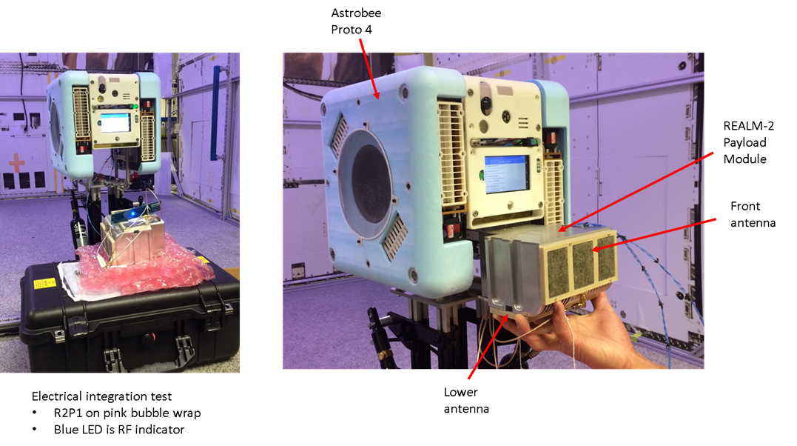
Accomplishments
Payload Interoperability Test
REALM payload (RFID reader) developed by AES Logistics project
Integrated to Astrobee Prototype 4
Verified power/data interface, read RFID tags, displayed tag info

Slide 6
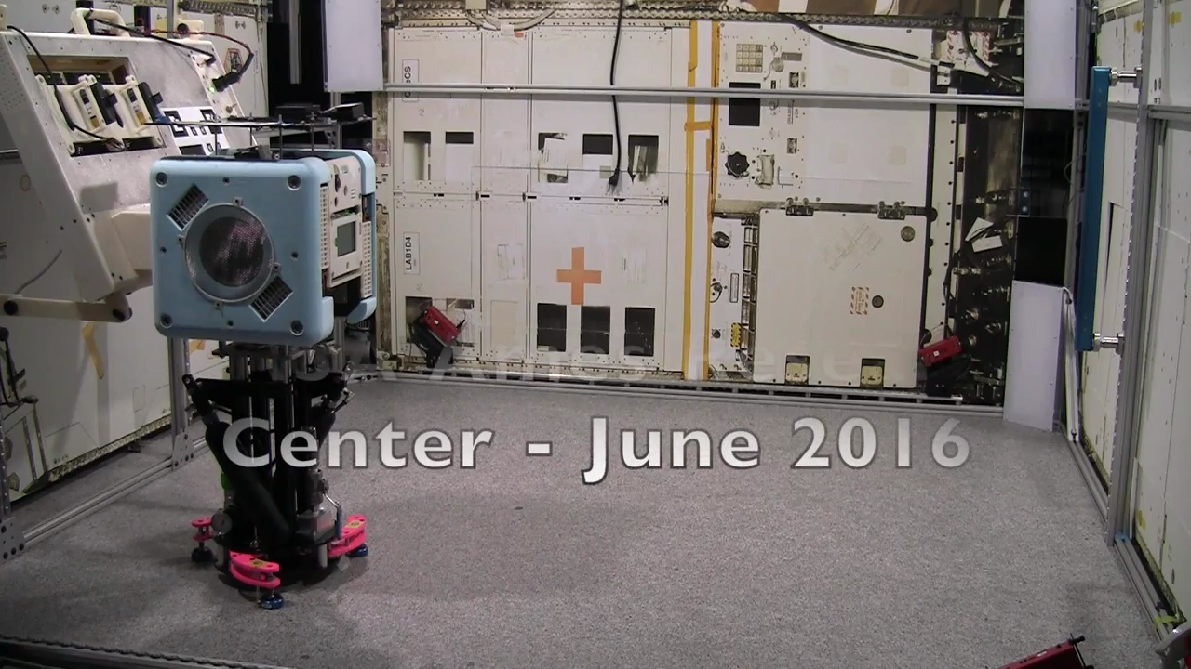
Navigation Demonstration

Slide 7
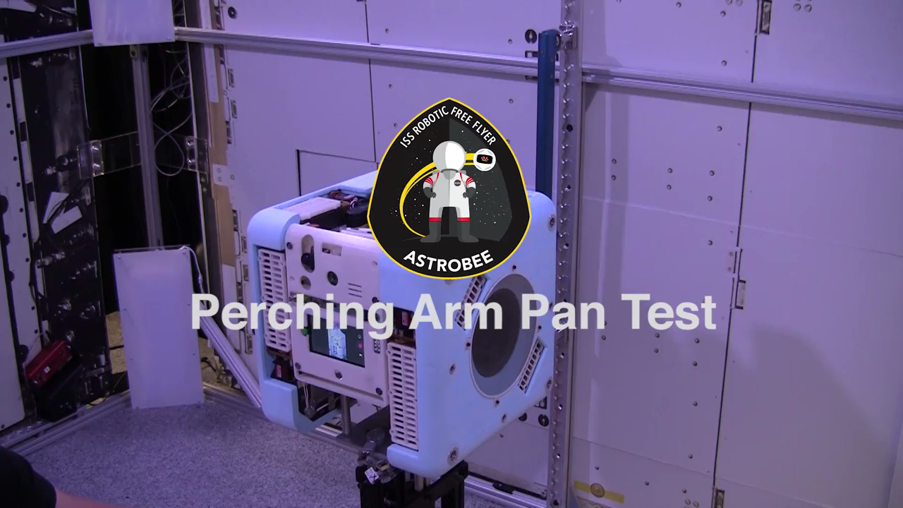
Perching Arm Demonstration

Slide 8
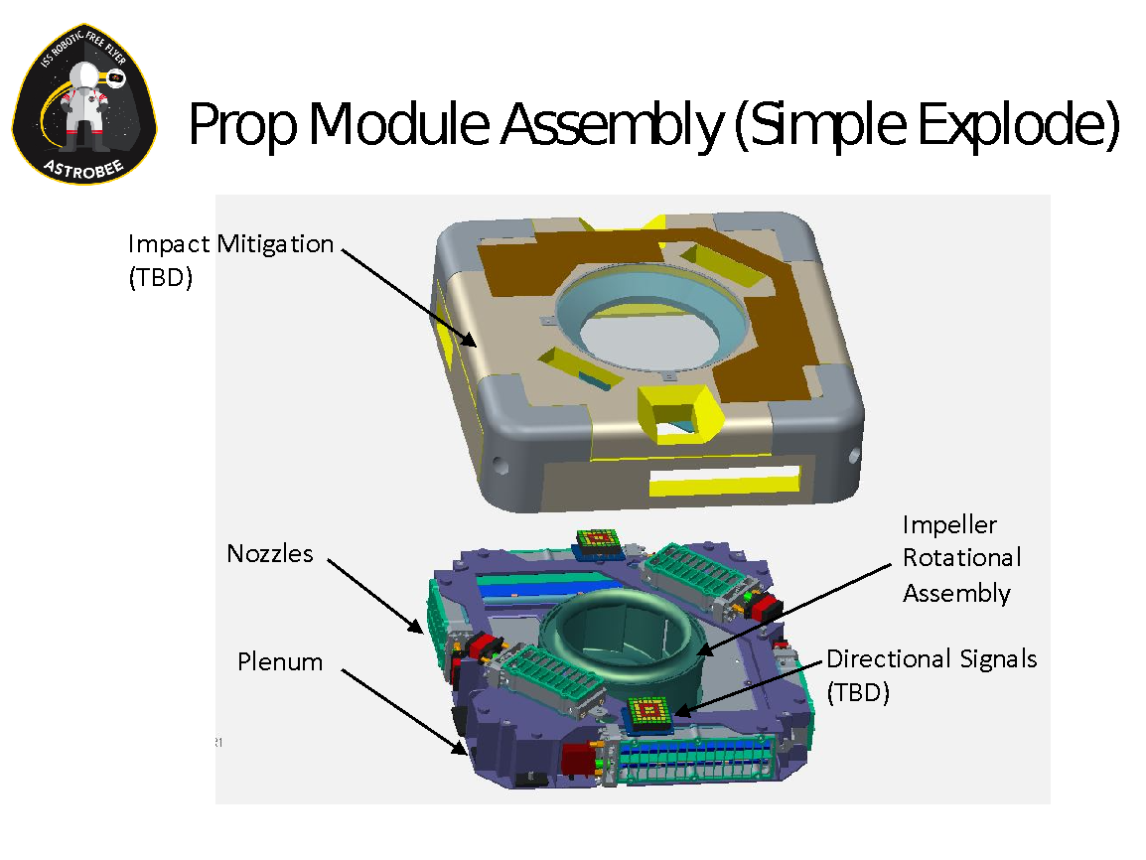
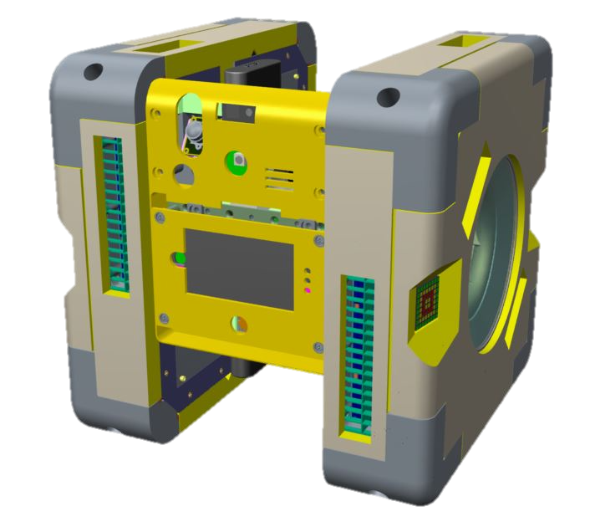
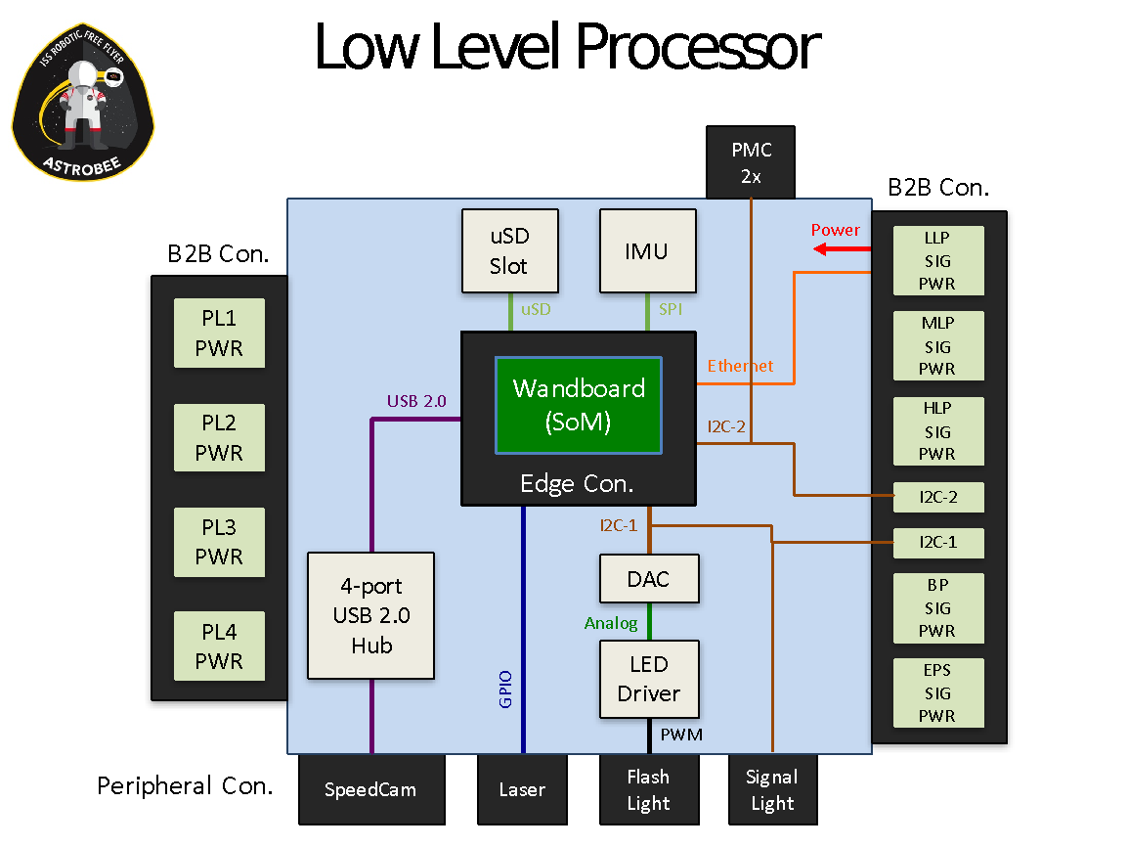
FY16 Accomplishments
Conducted Periodic Technical Review #3
Stakeholder review of design, prototype testing, safety, risks, cost and schedule
Similar to a Critical Design Review
Attendees: GCD, STMD, HEOMD, SPHERES, AES/LORE, ISS Crew Office, ISS Payloads, ISS FOD, and ARC mgmt.
Delta review is planned

Slide 9

FY16 Accomplishments
Conducted Payload Safety Review Panel (PSRP) #2
Reviewed Astrobee Safety Data Package
New and updated standard & unique hazards
Hazard controls are implemented
Verification methods identified
Potential safety non-compliance
Delta PSRP 2 is planned

Slide 10
Milestones and Forward Plans
Controlled | Description | Baseline | Actual | Estimated | Variance Explanation
Q1 – 10/1/2015 to 12/31/2015
 | R2 crew procedures for power fault troubleshooting | 11/30/2015 | 11/27/2015
 | R2 supervised midrange handrail localization | 12/31/2015 | 12/11/2015
Q2 – 1/1/2016 to 3/31/2016
 | Astrobee Prototype 4 ready for integration, validation, & test | 1/4/2016 | 1/4/2016
Q3 – 4/1/2016 to 6/30/2016
Astrobee FY16 #1 | Astrobee Prototype 4 testing complete | 4/25/2016 | 4/25/2016
Q4 – 7/1/2016 to 9/30/2016
✓
✓
✓
✓
Cert Unit subsystem builds
Subsystem procurements, manufacturing, assembly, testing

Slide 11
Summary and Significant Challenges
Project Summary Performance
Significant Challenges
Astrobee transition. Current baseline will produce flight units “ready to launch”, but not “ready to use” (customer expectation). Still waiting for official approval (decision memo) extending project through FY18 to perform on-orbit commissioning.
Period | Summary Performance |  |  |  | Rationale
 | Cost | Schedule | Technical | Programmatic
Q1 |  |  |  |  | Technical – Unresolved power fault with R2 on ISS Schedule – Lack of US crew time for R2 on-orbit activities Programmatic – Astrobee technology transition to customer will be incomplete if current project scope is not increased.
Q2 |  |  |  |  | Schedule – Astrobee schedule requires overlapping cert and flight unit builds to achieve “on dock” at end of FY17. Programmatic – Astrobee technology transition to customer will be incomplete if current project scope is not increased.
Q3 |  |  |  |  | Schedule – Astrobee schedule requires overlapping cert and flight unit builds to achieve “on dock” at end of FY17. Programmatic – Astrobee technology transition to customer will be incomplete if current project scope is not increased.

Slide 12
Back Up Charts
<These charts feed Quarterly Reporting. All charts are required. >

Slide 13

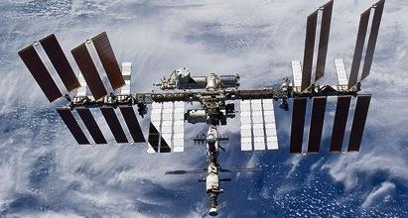
HET2 Overview
What would you say to a Senator that you meet in the elevator? The Human Exploration Telerobotics 2 project is developing remotely operated robots to improve the way humans live and work in space. These robots will perform routine housekeeping and in-flight maintenance jobs. “HET2 is developing new robots to do chores so that humans can focus on more important work”
Integration with other projects/programs and partnerships HEOMD STMD other AES: ASO & Logistics Reduction ISS: SPHERES Facility SBIR (2015 STMD subtopic) NSTRF (2011, 2012, 2013, 2014, 2015) Early Career Faculty (2014, 2015) Early Stage Innovation (2014, 2015) Google (NRSAA) | Technology Infusion Plans
Key Personnel Program Element Manager: Kevin Kempton Project Manager: Terry Fong Lead Center: ARC Supporting Centers: JPL NASA NPR: 7120.8 Guided or Competed: Guided Type of Technology: Push to ISS, Pull from AES | Key Facts GCD Theme: RRAS Execution Status: Year 2 of 3 Technology State Date: 10/1/2014 Technology End Date: 9/30/2017 Technology TRL Start: 3 Technology TRL End: 6 Technology Current TRL: 3 (Astrobee) Technology Lifecycle: Astrobee: Phase C (Implementation)

Slide 14
Astrobee Free-Flyer Element
What would you say to a Senator that you meet in the elevator? Astrobee is a free flying robot for inside the ISS. It will be used by flight controllers for doing mobile sensing and camera tasks. It will replace SPHERES to be used by researchers for 0g robotics testing. “Astrobee, free flying robot inside space station for mobile sensing and 0g robotics tests”
Integration with other projects/programs and partnerships HEOMD STMD other AES: ASO & Logistics Reduction ISS: SPHERES Facility SBIR STMD 2015 (Phase 2 project) STRG NSTRF (5 Ph.D. students) STRG ESI 2015 (4 projects) Google (NRSAA) | Technology Infusion Plans Technology: Free-flying robot Customer: HEOMD (ISS / AES) Use: ISS robotics testbed (SPHERES successor) ISS IVA work that requires mobile sensors (camera, RFID, etc.)
Key Personnel Program Element Manager: Kevin Kempton Project Manager: Terry Fong Lead Center: ARC Supporting Centers: JPL NASA NPR: 7120.8 Guided or Competed: Guided Type of Technology: Push to ISS Program Pull from HEOMD (ISS SPHERES and AES) | Key Facts GCD Theme: RRAS Execution Status: Year 2 of 3 Technology State Date: 10/1/2014 Technology End Date: 9/30/2017 Technology TRL Start: 3 Technology TRL End: 6 Technology Current TRL: 4 Technology Lifecycle: Phase C (Implementation)

Slide 15
Astrobee Performance
Technology Advancements
Vision based navigation using AR targets and sparse mapping
Robotic perching arm development and pan/tilt operations
Closed loop control using fan-based propulsion
Technology advances mean …
Reduced risk in robot localization & docking performance
The algorithms selected for localization provide accurate solutions
The robot is able to dock using only vision
Perching arm design validation – the arm can be used to grasp the handrail, pan & tilt the free flyer without losing grip
6-DOF holonomic control of a free flying robot with an all-electric propulsion system
Is the technology push or pull?
Astrobee robot is a pull from HEOMD (AES) and push to ISS operations
Subsystem technology choices are push

Slide 16
Astrobee Performance
Key Performance Parameters
Performance Parameter | State of the Art | Threshold Value | Project Goal
Max velocity | 4 cm/sec | 10 cm/sec | 40 cm/sec
Flight time | 0.5 hr | 2 hr | 5 hr
Dock & resupply | Crew tended | Crew tended | Autonomous
# peripheral ports | 1 | 2 | 4
Consumables used per ISS test session | 6 | 0 | 0
ISS operational space | 2m x 2m x 2m | JEM, US Lab, and Node 2 | All USOS

Slide 17
Risk Summary
L
I
K
E
L
I
H
O
O
D
Risk ID Trend | Approach Affinity | Astrobee Risk
1 | M T | Pose accuracy with vision-based navigation (FFREQ-42)
2 | M T | Avionics and fan noise (FFREQ-47)
3 | R T | Safety approval of autonomous operations (FFREQ-49)
4 | M T | Performance trades: fans, batteries, size (FFREQ-44)
5 | W Sc | Schedule is best case (FFREQ-46)
14 | M T | Technology transition is incomplete (FFREQ-1194)
5
⬅
4
⬅
3, 5
3
⬅
4
1
14
⬅
2
2
⬅
1
⬅
1
2
3
4
5
CONSEQUENCES
Criticality
L x C Trend
Decreasing (Improving)
Increasing (Worsening)
Unchanged
New Since Last Period
Approach
M - Mitigate
W - Watch
A - Accept
R - Research
High
⬅
⬅
Med
⬅
Low
Affinity T - Technical C - Cost
Sa - Safety Sc - Schedule

Slide 18
HET2 Risks
Risk ID #
1
Trend
Criticality
Current L/C
2x3
Affinity Group
Technical
Planned Closure
9/30/17
Open Date
10/1/2014
Pose accuracy with vision-based navigation (FFREQ-42)
Risk Statement Approach: Mitigate
Given that a solution for vision-based navigation in a free-flying robot has limited resources (size, power, computation), there is a possibility that pose estimation will not meet the required accuracy, resulting in poor performance for some 0g robotics research tasks.
Context
VBN likely to provide sufficient resolution for general navigation. AR target will be used for docking. Additional targets may be needed in a small area to provide accurate pose estimations for 0g robotics research.
Status
7/2016. Localization and vision-based navigation testing using the P4 hardware platform has been successful; indicates system is on track to meet requirements
Med
Mitigation Steps | Dollars to implement | Trigger/ Start date | Schedule UID | Completion Date | Resulting L/C
P2 testing with AR tracking. |  | 2/5/15 |  | 2/15/15 | 3x5
P3 testing |  | 7/1/15 |  | 9/1/15 | 3x3
P4 requirements development |  | 9/15/15 |  | 12/15/15 | 3x3
P4 testing |  | 2/12/16 |  | 6/21/16 | 2x3
Cert Unit testing |  | 12/1/16 |  | 9/30/17 | 2x2

Slide 19
HET2 Risks
Risk ID #
2
Trend
Criticality
Current L/C
1x1
Affinity Group
Technical
Planned Closure
5/1/2017
Open Date
10/1/2014
Avionics and fan noise (FFREQ-47)
Risk Statement Approach: Mitigate
Given that avionics and fans make noise, there is a possibility that the desired Astrobee design will not meet ISS safety standards, resulting in either it not being certified for operations on ISS, or a fan design with low noise but inferior performance will be used.
Context
The ISS has limitations on the amount of noise caused by a payload, both continuously and intermittently. The Astrobee team will need to find/design high performance fans that fall within the noise limits.
Status
7/2016. Acoustics test performed with the Prototype 4 unit; tests reveal insufficient margin, but still within threshold.
Low
Mitigation Steps | Dollars to implement | Trigger/ Start date | Schedule UID | Completion Date | Resulting L/C
Requirements review with ISS Acoustics group |  | 1/21/15 |  | 2/4/15 | 3x4
Propulsion subsystem testing. |  | 3/1/15 |  | 7/30/15 | 3x3
Test fans in flight-like configuration |  | 2/15/16 |  | 5/31/16 | 2x2
Requirement exceptions approved |  | 1/15/17 |  | 5/1/17 | 1x1

Slide 20
HET2 Risks
Risk ID #
3
Trend
Criticality
Current L/C
3x4
Affinity Group
Technical
Planned Closure
9/15/2017
Open Date
10/1/2014
Safety approval of operations without crew tending (FFREQ-49)
Risk Statement Approach: Research
Given that Astrobee is a collision hazard on ISS, there is a possibility that the planned hazard controls will not be approved by the ISS safety panel, resulting in Astrobee not being approved for autonomous operations on ISS.
Context
The Payload Safety Review Panel (PSRP) at JSC approves all ISS payloads. The PSRP has a standard set of hazards that each payload must assess and prove that the hazard is not applicable or mitigated. The team must also determine if there are other unique hazards for their payload. For a free flying robot, the possibility of collisions is a unique hazard. Mitigating this hazard for an autonomous Astrobee (meaning crew cannot be used for hazard mitigation) will be a significant challenge
Status
7/2016. At PSRP 2, crew collisions with Astrobee defined as safety critical; will require safety equivalent non-compliance report at SSPCB.
Med
Mitigation Steps | Dollars to implement | Trigger/ Start date | Schedule UID | Completion Date | Resulting L/C
Review safety critical FSW approach with R2. |  | 3/6/15 |  | 3/6/15 | 3x4
Conduct TIMs with PSRP/CSP as needed; hazards approval at PSRP 1 |  | 4/1/15 |  | 9/15/15 | 2x4
Conduct TIMs as needed; mitigation methods approval at PSRP 2 |  | 9/15/15 |  | 6/8/16 | 1x4
Final safety approval at PSRP 3 |  | 3/15/16 |  | 9/15/17 | 1x1

Slide 21
HET2 Risks
Risk ID #
4
Trend
Criticality
Current L/C
2x2
Affinity Group
Technical
Planned Closure
5/25/2016
Open Date
1/7/2015
Performance Trades: fans, batteries, size (FFREQ-44)
Risk Statement Approach: Mitigate
Given that multiple fans and batteries may cause the overall system dimensions to increase beyond the desired size limits, there is a possibility that a trade off between holonomic control, thrust, run time and size must be made, resulting in not all stakeholder expectations being met.
Context
Electric fans will provide better energy efficiency for the intended use cases rather than a pressurized system. Multiple fans are required for 6 DOF holonomic control. Larger batteries are needed to provide sufficient run time. Size must be limited for the robot to be human-friendly, fit through hatches, and stay out of the crew’s way.
Status
7/2016. Design presented to stakeholders at PTR 3. Delta review expected in early fall; this risk will close at that time.
Low
Mitigation Steps | Dollars to implement | Trigger/ Start date | Schedule UID | Completion Date | Resulting L/C
Review requirements and point design with customers at PTR1 |  | 2/10/15 |  | 2/25/15 | 3x4
Get AES priority (holonomic, run time, thrust, size); factor into new trade study |  | 2/25/15 |  | 3/1/15 | 3x4
Present new point design to customer. |  | 3/18/15 |  | 3/23/15 | 3x3
Present preliminary design to stakeholders at PTR 2. |  | 9/1/15 |  | 9/15/15 | 3x2
Present final design to stakeholders at PTR 3. |  | 10/1/15 |  | 6/23/16 | 2x2

Slide 22
HET2 Risks
Risk ID #
5
Trend
Criticality
Current L/C
3x4
Affinity Group
Schedule
Planned Closure
9/30/2017
Open Date
10/1/2014
Cert/Flight Unit schedule (FFREQ-46)
Risk Statement Approach: Watch
Given the serial Prototyping and Flight development efforts, there is a possibility that the flight unit delivery will extend beyond the project baseline schedule.
Context
The Astrobee development approach uses iterative prototyping to refine requirements, mature design, and reduce risk, thus the efforts are in series.
Status
7/2016. Overlap between Cert Unit and Flight Unit schedules in order to stay within project baseline. This summer/fall will assess what parts of Flight Unit can be accelerated to meet schedule.
Med
Mitigation Steps | Dollars to implement | Trigger/ Start date | Schedule UID | Completion Date | Resulting L/C
Baseline schedule with optimized distribution of reserve and slack for PTR 1. |  | 2/20/15 |  | 2/25/15 | 4x5
Release reserve in P4. |  |  |  | 3/1/16 | 4x5
Assess impact of P4 lessons learned on Cert Unit schedule. |  | 2/25/16 |  | 6/23/16 | 4x5
Release reserve in Cert Unit. |  |  |  | 3/1/17 | 3x5
Assess impact of Cert Unit lessons learned on Flight Unit schedule. |  | 3/1/17 |  | 9/30/17 | 3x5

Slide 23
HET2 Risks
Risk ID #
14
Trend
Criticality
Current L/C
2x4
Affinity Group
Technical
Planned Closure
9/30/2016
Open Date
9/24/15
Technology transition is incomplete (FFREQ-1194)
Risk Statement Approach: Mitigate
Given that the baselined project schedule ends when the Free Flyers are delivered on-dock, ISS checkout activities will require Astrobee engineering support, and robot software will need modification based on performance on ISS, there is a possibility that the Astrobee engineers will not be available to support the SPHERES Program and the kickoff of Astrobee operations, resulting in loss of on-orbit time.
Context
The project baseline ends when the Astrobee is delivered for launch to ISS. However, Astrobee software development is required during initial on-orbit activities to build ISS maps for vision based navigation and to adjust the localization based on performance. Without this Astrobee support, the SPHERES team will not be able to deploy Astrobee for payload operations.
Status
7/2016. Submitted FY18 extension proposal to GCD. Waiting for decision memo (or other) that documents the revised Element baseline.
Med
Mitigation Steps | Dollars to implement | Trigger/ Start date | Schedule UID | Completion Date | Resulting L/C
FY18 new start proposal approved |  |  |  |  | 4x5
(Budget process)
FY18 budget approved

Slide 24
Excel File: STMD and GCD Data Request
Technology Transfer or Infusion
EPO: Activities, Conferences, and Students
Economic Development
STMD Data Analysis Tool – If new project
Post Excel File to the following link on NX: https://nx.larc.nasa.gov/dsweb/View/Collection-87500
Use Excel file sent with the template and located on NX

Slide 25
Astrobee Penta
Crew performs many tasks that could be performed by a robot
Crew spends half of a SPHERES session setting up and tearing down equipment
Crew time spent conducting hand-held sensor tasks and setting up cameras and 0g robotics research platform in ISS
Developing ISS free-flying robotic technology to TRL 6: vision-based navigation, fan-based propulsion, ISS 3D path planning, 0g robotic perching.
Astrobee is a free flying robot capable of autonomous flight and performing mobile sensor tasks on ISS.
Astrobee will provide camera views to flight controllers to improve situational awareness.
Astrobee will autonomously dock and resupply consumables.
Astrobee can be pre-positioned for 0g robotics research sessions.
ISS Program is interested in off loading crew activities.
ISS Program and AES want to reinvest in ISS as a research platform.
AES wants to pursue automated logistics management.
Deliver (on dock) 2 free-flying robots capable of ISS IVA sensor tasks and autonomous docking.
Stretch goal: Launch and perform on-orbit checkout.

